Slide 1
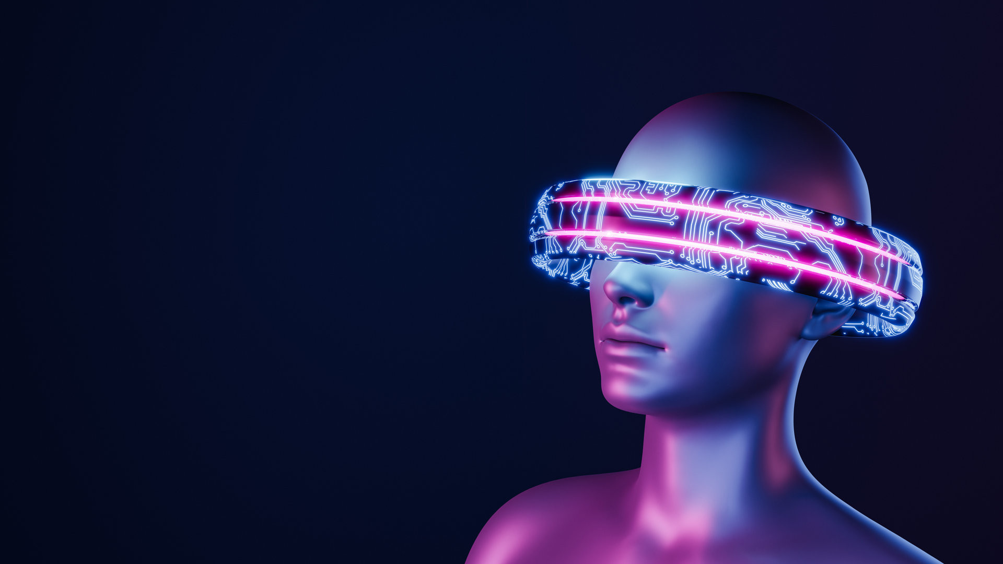
METAVERSE
By: Iqra Naz
CNC005102

Slide 2

AGENDA
History
Concept
Key Technologies
Current Projects
Expected Security Risks
Evolution Spectrum of Metaverse
Conclusion

Slide 3
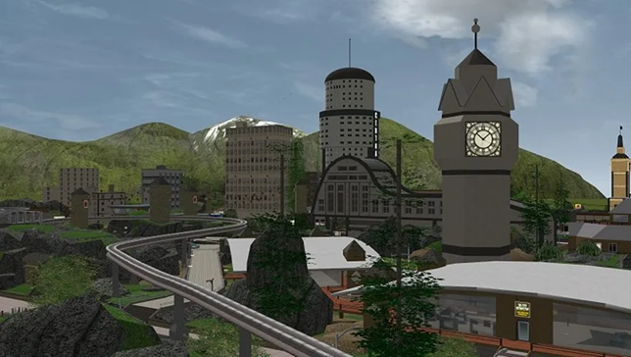
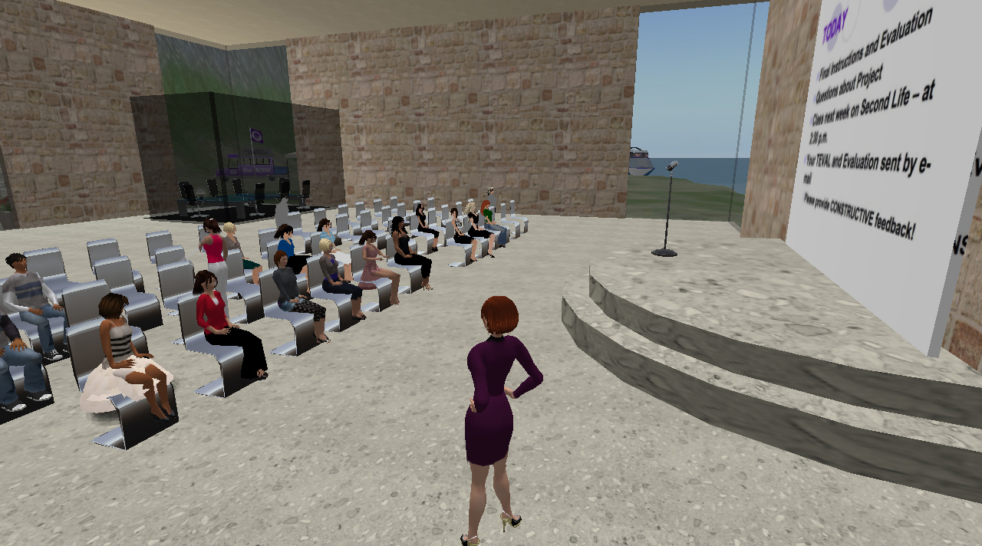
BACKGROUND
Neil Stephenson, coined the term “Metaverse” in snowcrash
Inspired creation of virtual worlds like “Active worlds” and “Second Life”.
Ready Player One and Facebook rebranding to Meta increased Metaverse Popularity

Slide 4
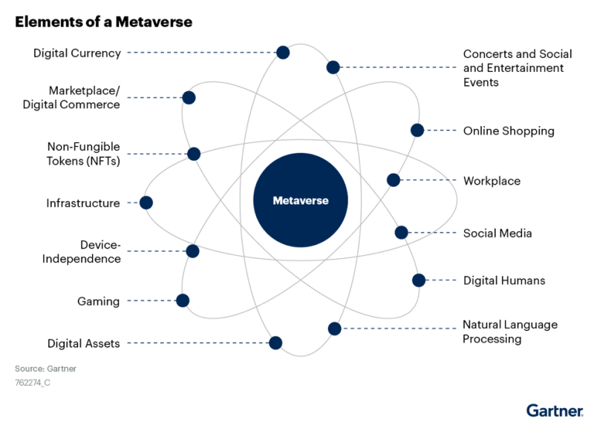
CONCEPT
A hypothetical concept of the Internet as a single
universal and immersive virtual worlds visualized through AR/VR headsets
built on technologies Artificial intelligence, 3D construction, Internet of Everything and blockchain.

Slide 5
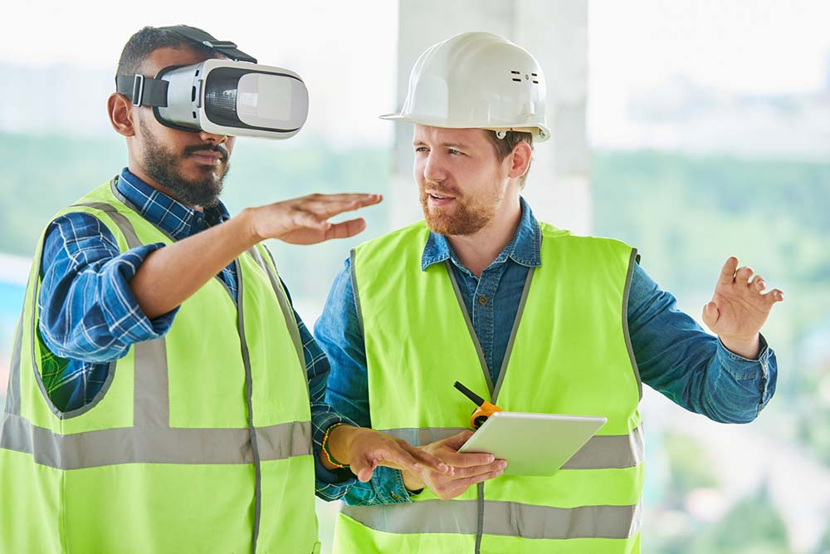
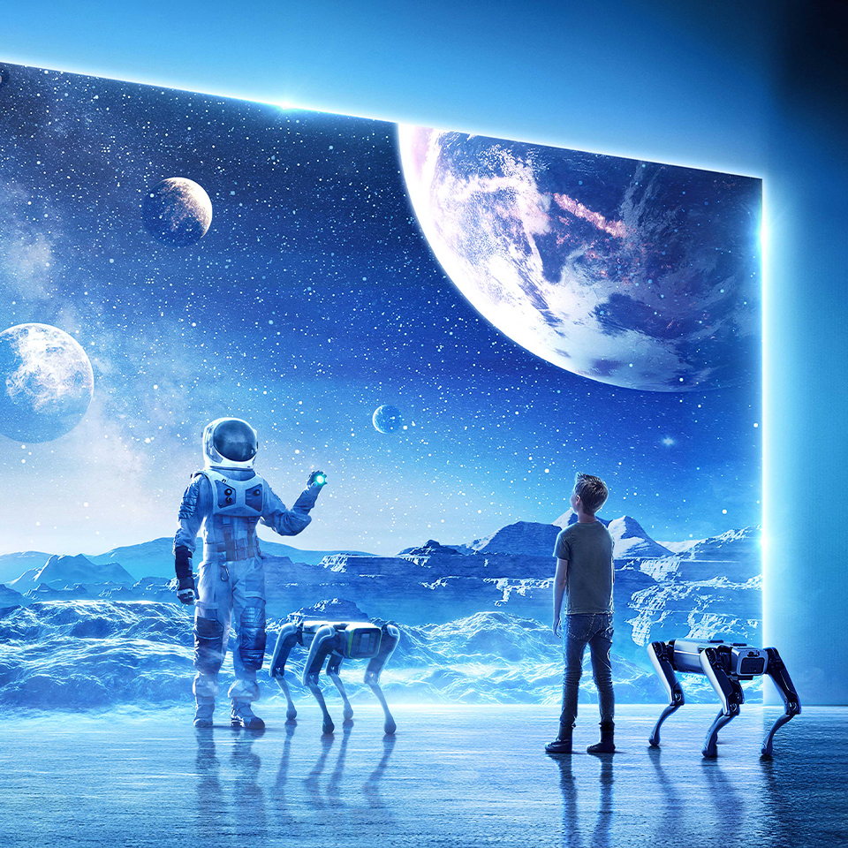
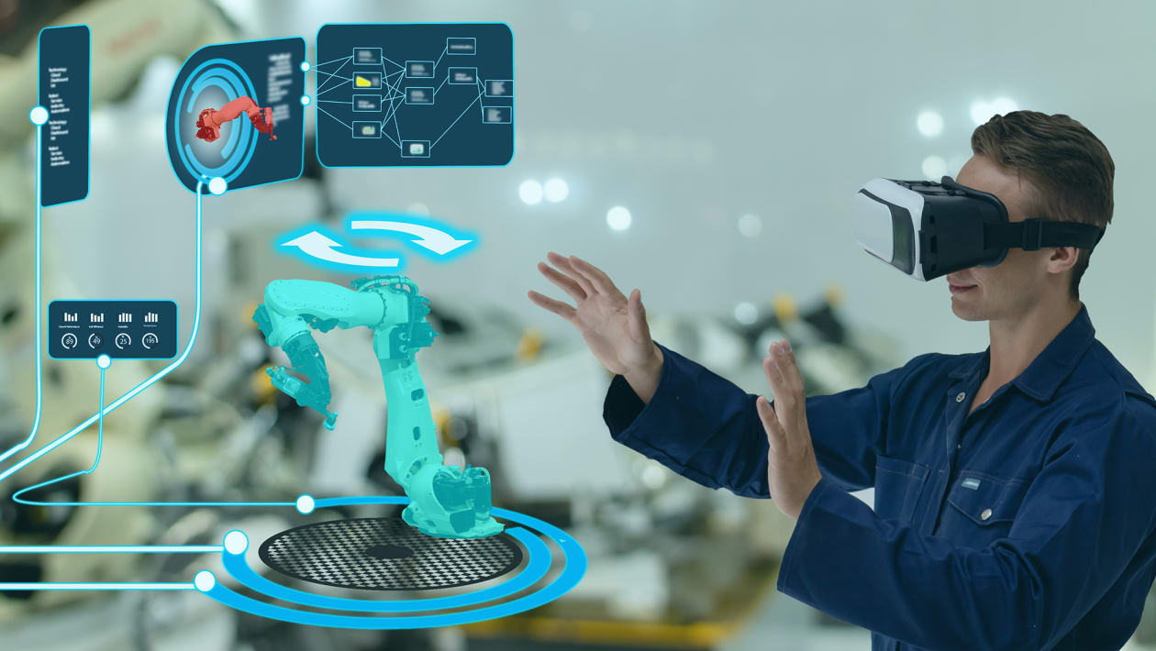
METAVERSE: AN EXTENSION TO REALITY
Experience things you cannot do in real life
Make use of digital world to conduct dangerous real-life training simulations
Examples : surgical trainings, phobia therapy, luxury items.

Slide 6
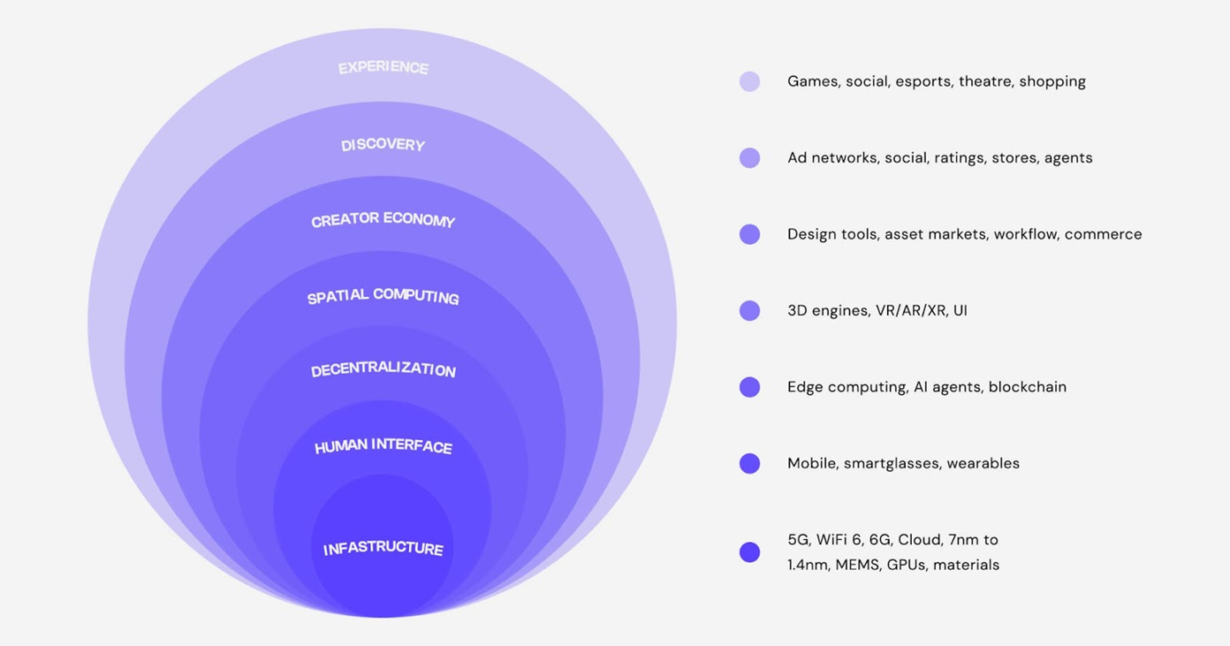
SEVEN LAYERS OF METAVERSE

Slide 7
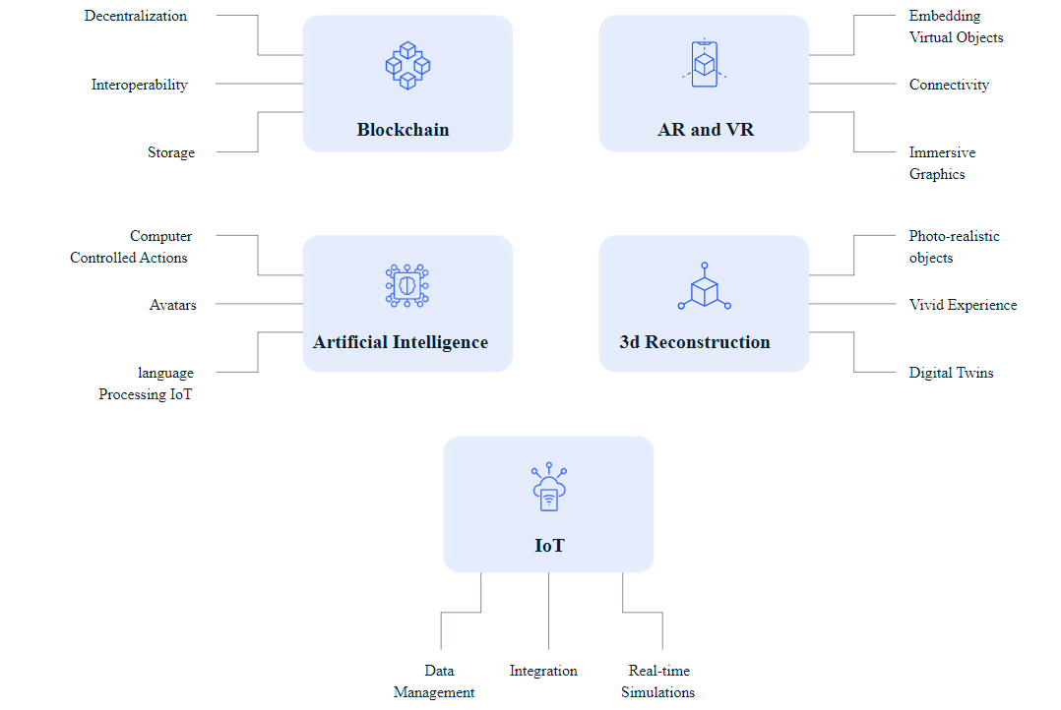
KEY TECHNOLOGIES

Slide 8
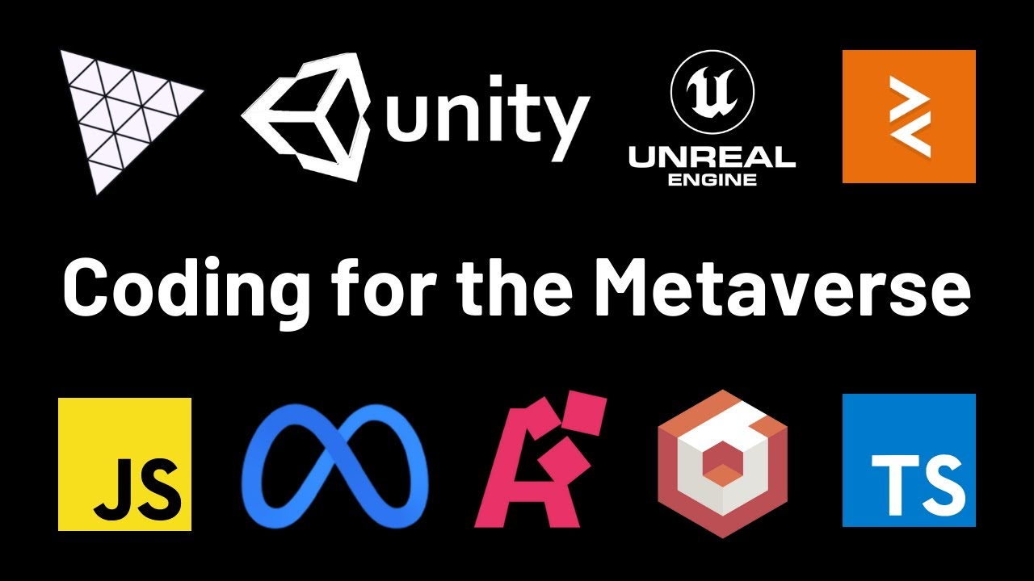
TECHNOLOGY STACK
BLOCKCHAIN: Solidity, Rust, Node.js, react, mongoDB, auth, JavaScript-based framework; React-native, HTML, CSS, Websocket, Web3js,
AR/VR: Unity, Unreal Engine, Google Arcore, Apple Arkit, Three.js, Babylon.js
AI DEVELOPMENT: AWS Sage maker, Tensorflow, Sicklit
3D CONSTRUCTION: Unity, Unreal, Blender, Maya
IOT: MQTT, Azure IOT Hub, Lorawan, AMQP

Slide 9
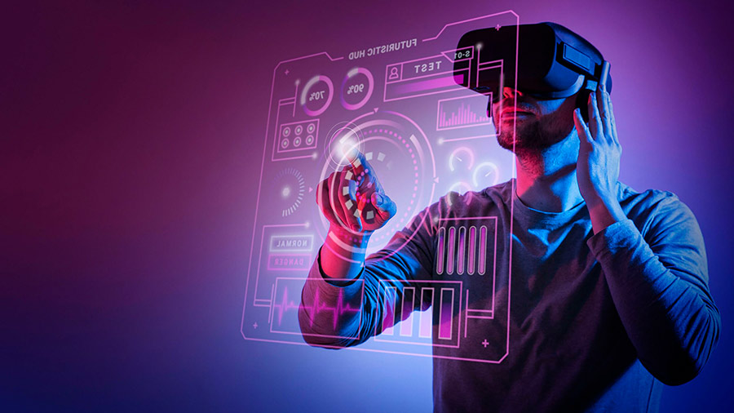
VR HEADSETS:
Meta Oculus Quest 2
HTC Vive Pro Focus Plus
Valve Index VR HMD
HP Reverb G2
Pimax Vision 8K X
Metaverses that support VR:
Roblox, Cryptovoxels, Somnium Space,
Sandbox

Slide 10
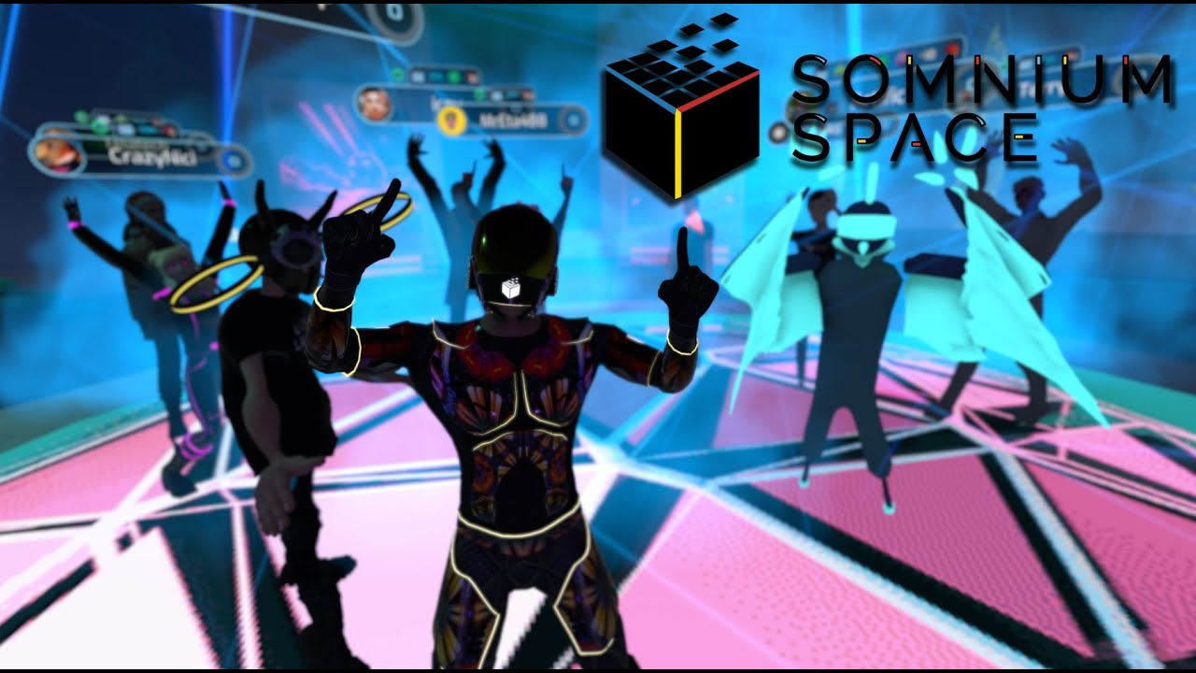
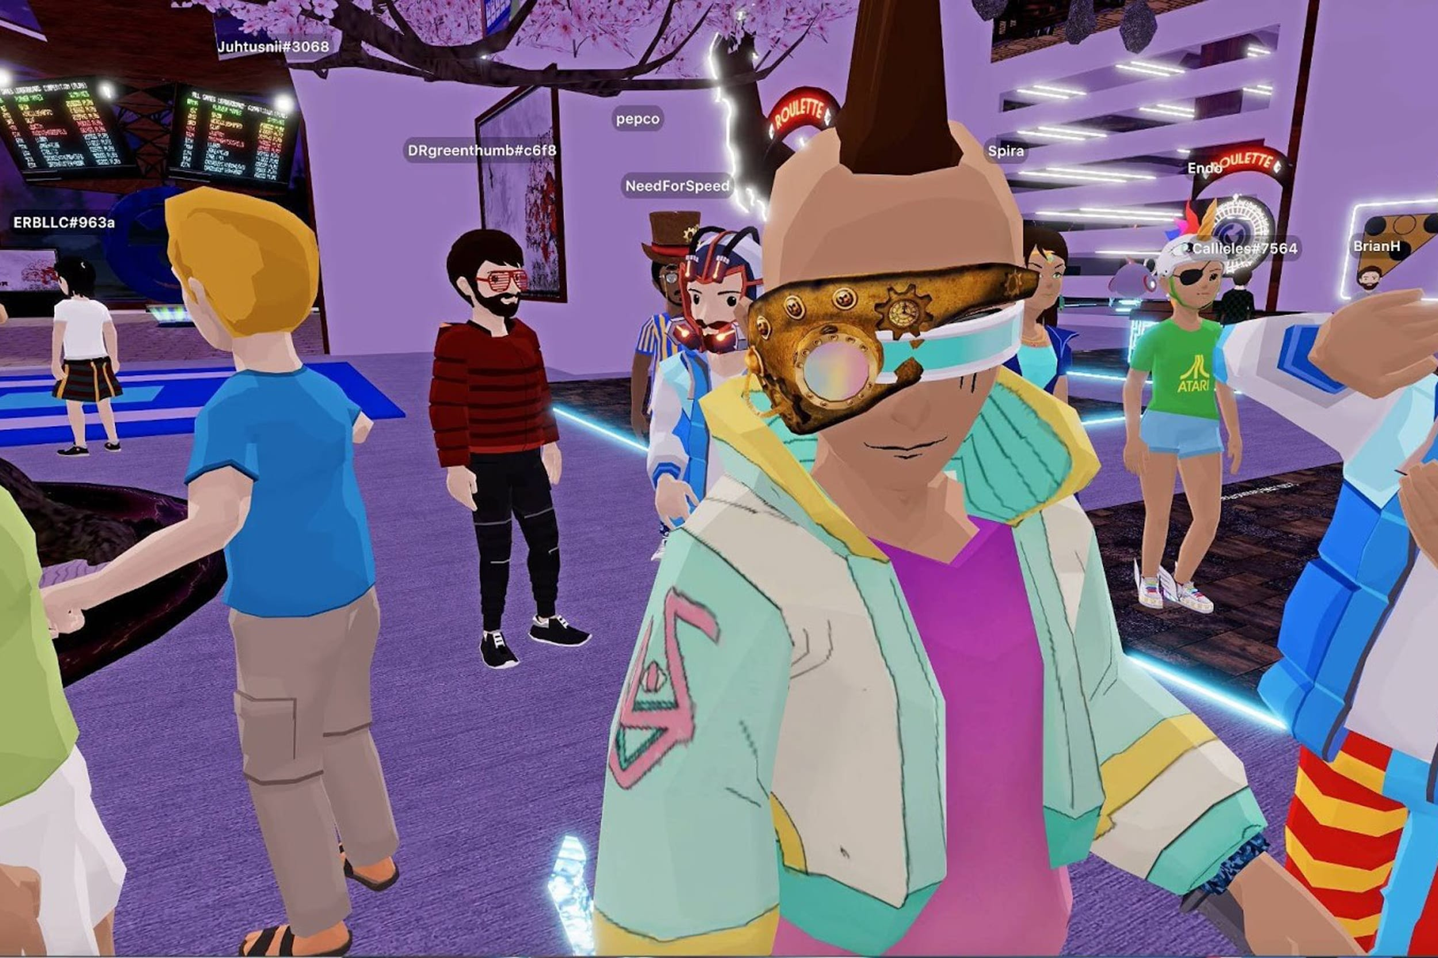
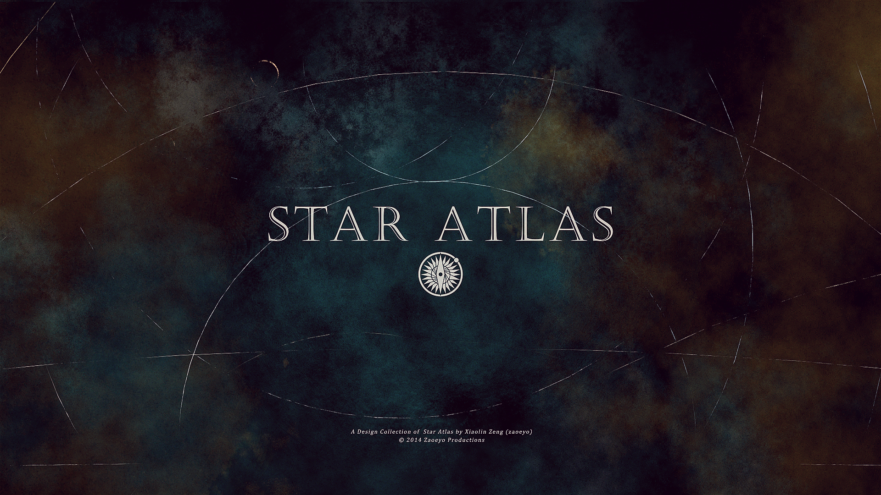
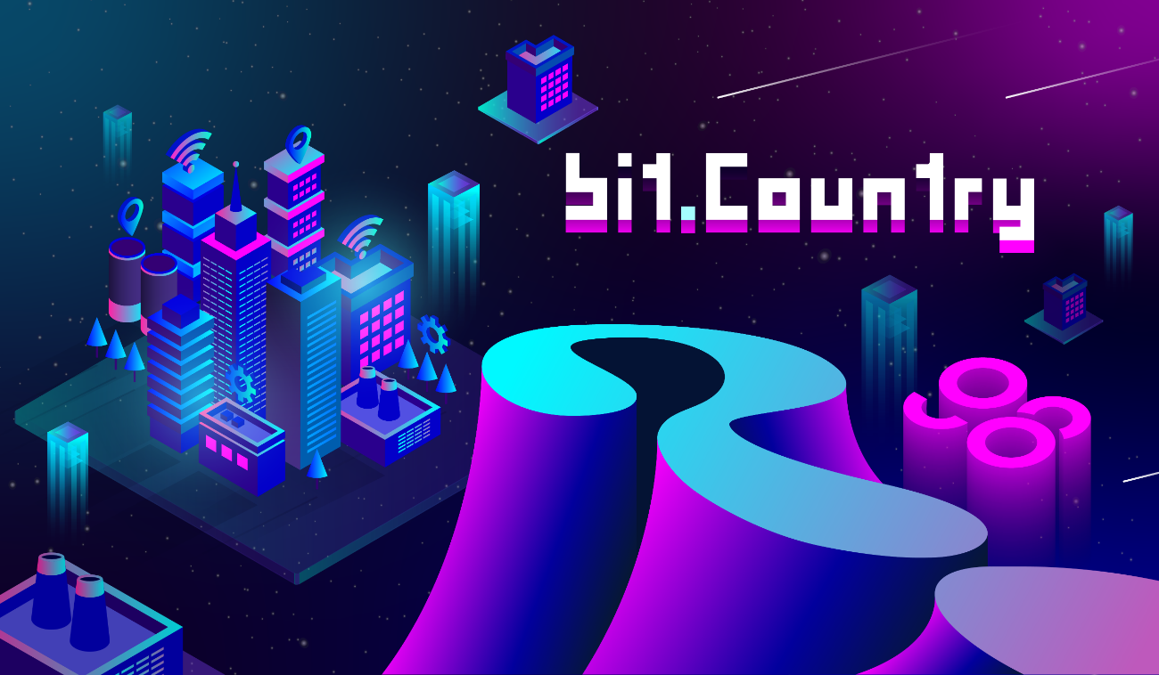
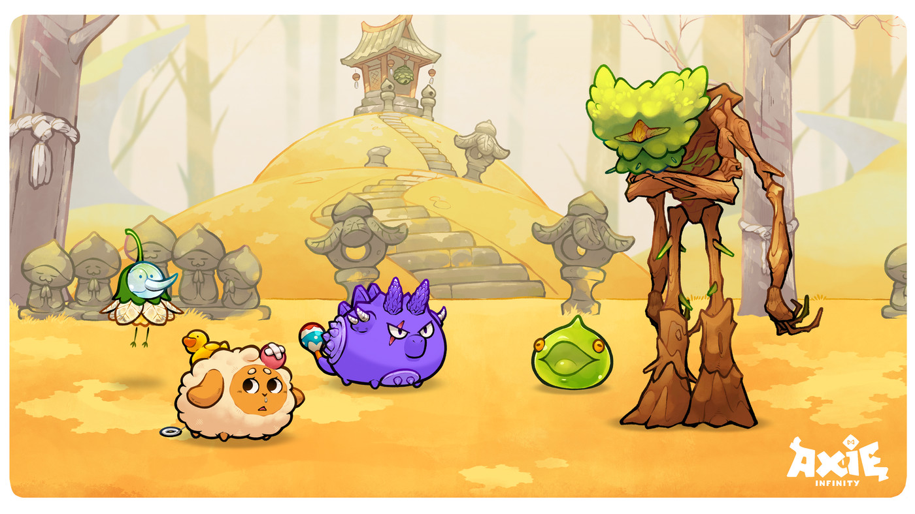
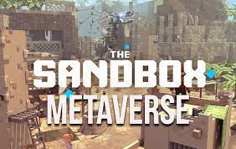
RECENT PROJECTS
Currently, there are many different projects in pipeline, that try to emulate the concept of metaverse
Such Examples include
Decentraland
Sandbox
Axie Infinity
bit.Country
Somnium Space

Slide 11
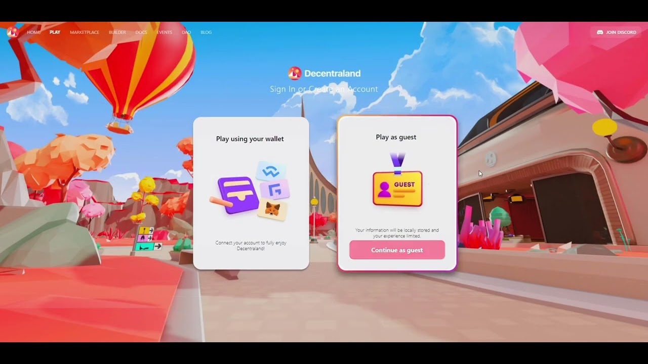
DECENTRALAND
A virtual world where you can buy lands, digital assets, socialize, attend live events, or even work.
Mana is used as cryptocurrency
Events like Fashion Week are hosted in which major fashion brands appear, including Dolce & Gabbana, Tommy Hilfiger, Elie Saab, and Estée Lauder

Slide 12
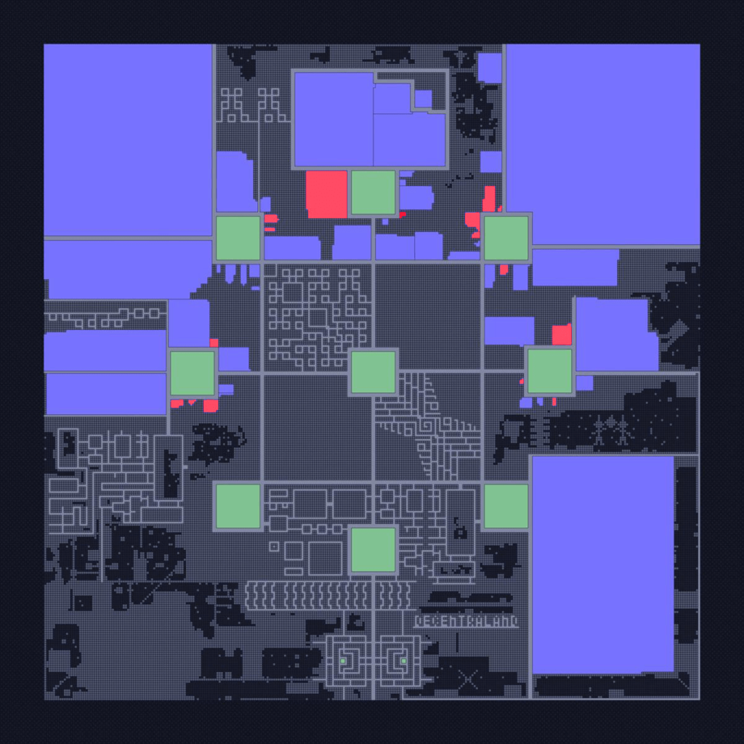
DECENTRALAND
In April 2021, during a surge in popularity for NFTs, parcels sold for between $6,000 and $100,000
Major Brands have bought land such as Samsung, Adidas.

Slide 13
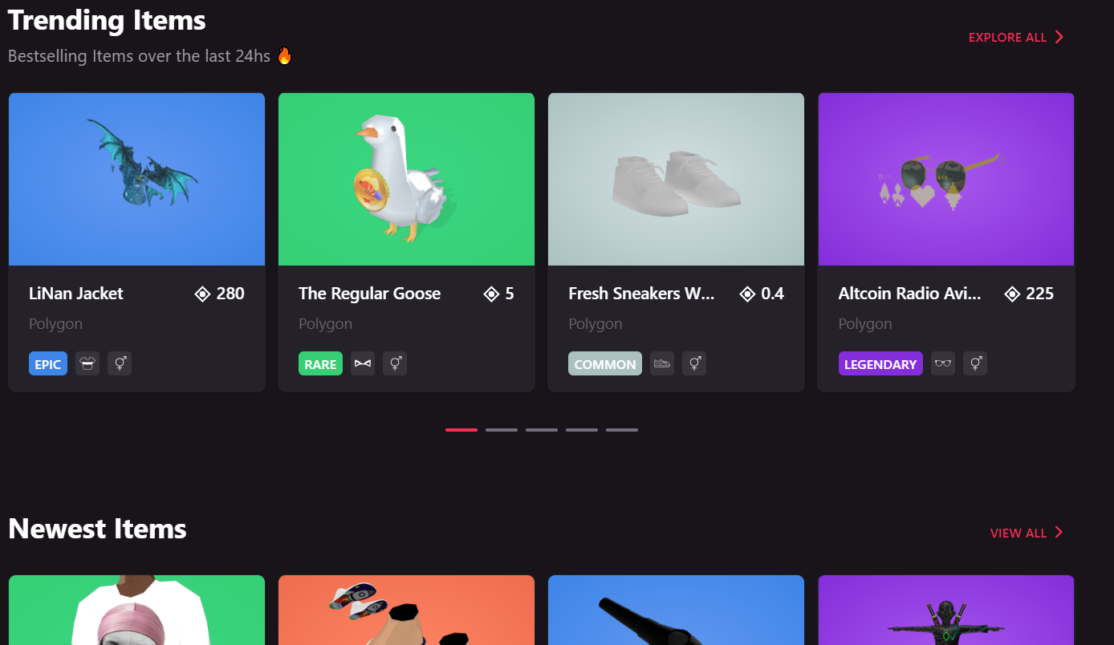
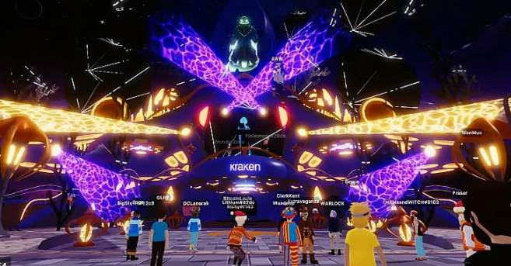
DECENTRALAND
Live events are conducted
You can buy land and build game on it
You can sell and create wearables
The games and experiences on decentraland is created using typescript

Slide 14
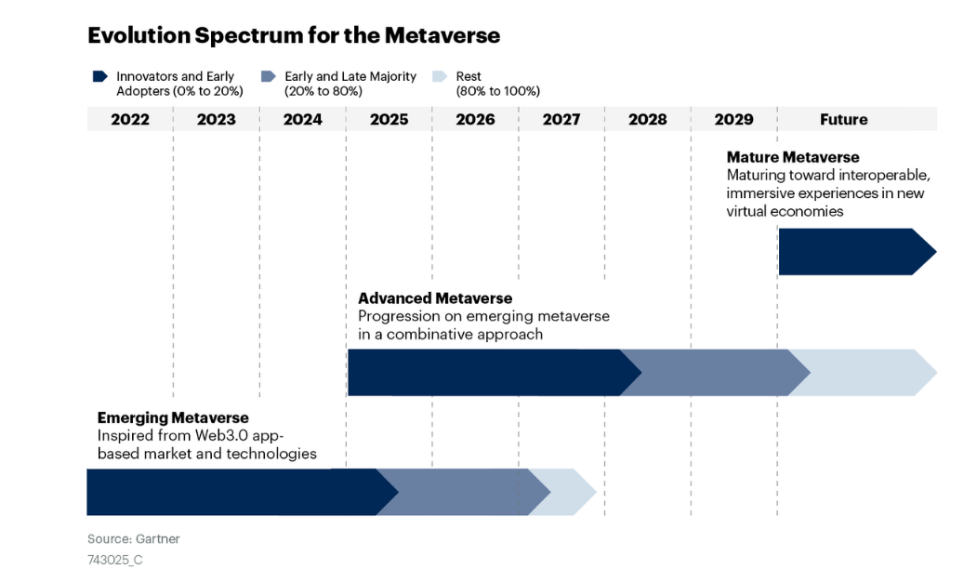
EVOLUTION SPECTRUM OF THE METAVERSE

Slide 15

PHASE 1 – Emerging Metaverse
Current phase of commercially available products
No interoperability between metaverses
Cannot move to different applications by yourself
No standards defined for interoperability
May Last till 2024

Slide 16

PHASE 2 – ADVANCED METAVERSE
Convergence of technologies to enable mature solutions
Methods to link physical world to digital world
Technology to sense and map people, places, things and processes. This will also involve graph technologies that establish processes and relationships between these elements.
Integration of Sensor technologies, sensor fusion and technologies that enable data integration.
Interoperability standards and protocols

Slide 17
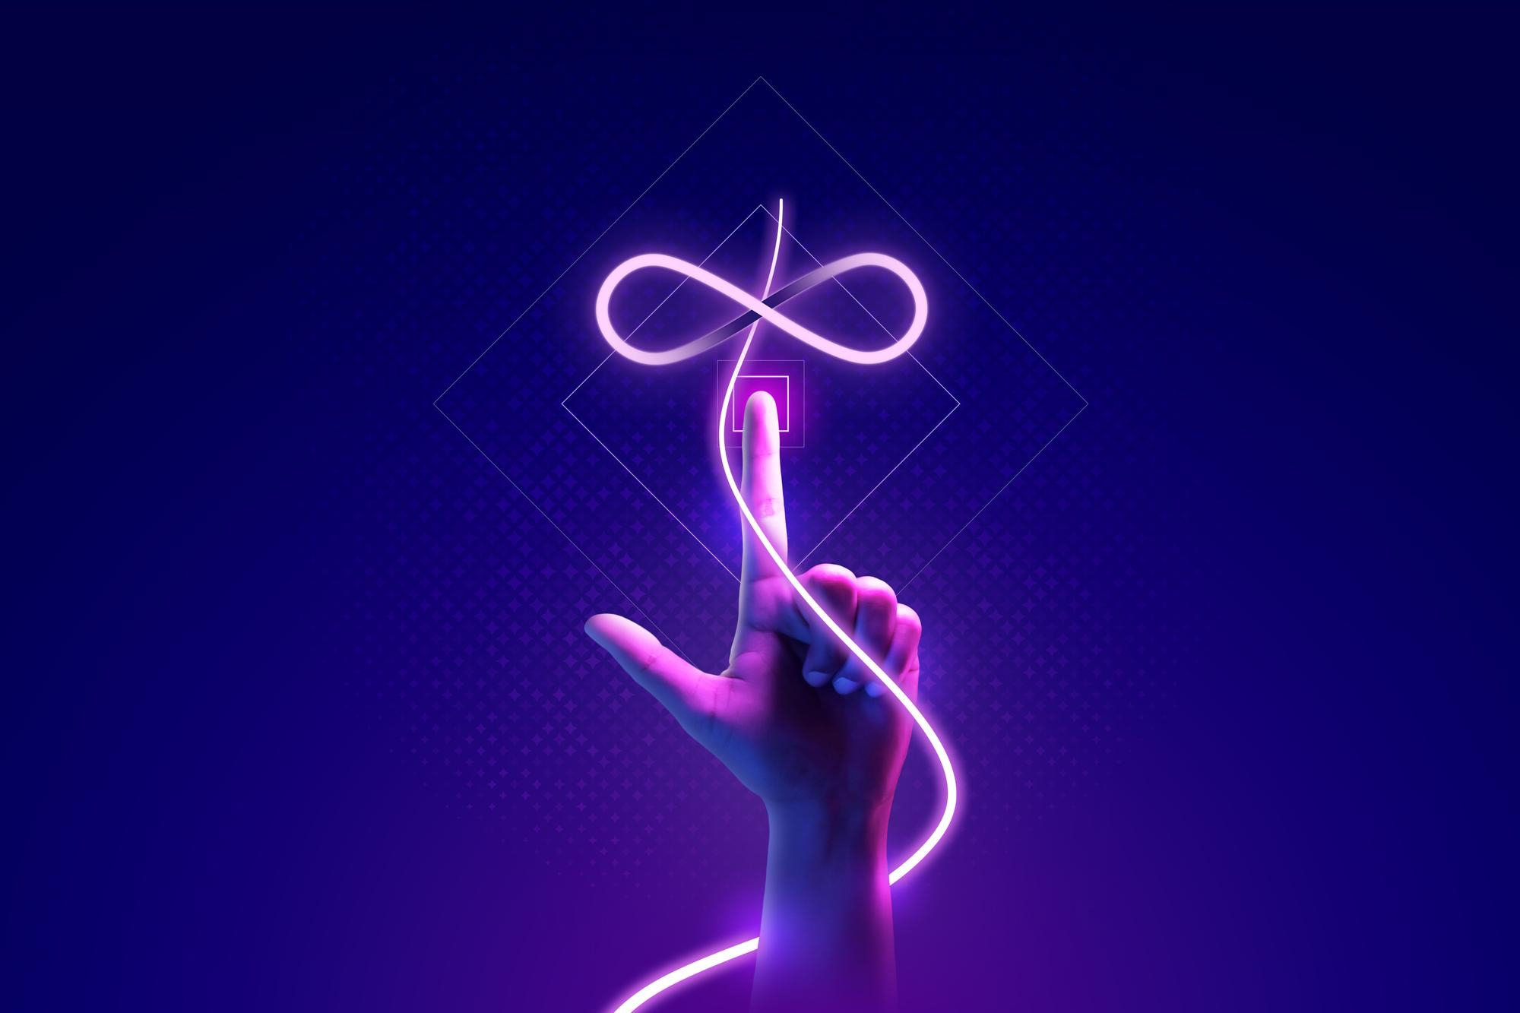
PHASE 3 - MATURE METAVERSE
Collaboration and interoperability
Real-time localized content updates
AI-powered self-construction of 3D spaces

Slide 18
SECURITY RISKS IN METAVERSE
Cyber Bullying and Harassment
Theft of Virtual Objects (Crypto Currency, NFT)
Identity Theft of a person in Metaverse
Fraud and Ponzi Schemes (Pre-booking/Land sale Scams)
Ransomware Attacks in Metaverse
Social Engineering Attacks
Money Laundering

Slide 19
CONCLUSION
In short, the possibilities of metaverse seem endless yet enticing, difficult to speculate its final stage. Should we expect it all to go down without ever reaching the advanced stage? Or should we anticipate metaverse giants or perhaps underdogs revolutionizing the tech industry?

Slide 20
THANK YOU

